Slide 1


Lecture 1-2
DLI
Round-off Errors and Computer Arithmetic

Slide 2
DLI
Comparison
(1) In our traditional mathematical world, is a unique positive number, when multiplied by itself produces the integer 3.
(2) In the computational world, is not rational, it is given an approximate representation, one whose square will not be precisely 3, although it will likely be sufficiently close to 3 to be acceptable in most situations.
The error that is produced when a calculator or computer is used to perform real number calculations is called round-off error.

Slide 3
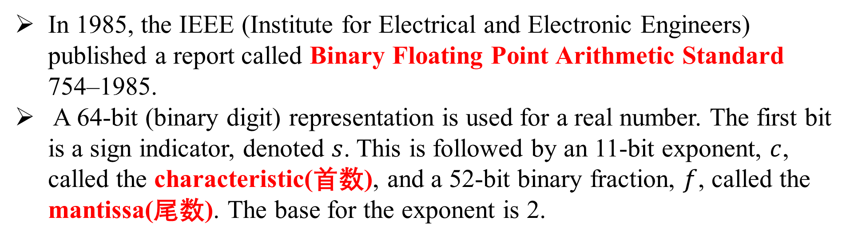
DLI
Binary Machine Numbers
In 1985, the IEEE (Institute for Electrical and Electronic Engineers) published a report called Binary Floating Point Arithmetic Standard 754–1985.
A 64-bit (binary digit) representation is used for a real number. The first bit is a sign indicator, denoted $s$. This is followed by an 11-bit exponent, $c$, called the characteristic(首数), and a 52-bit binary fraction, $f$, called the mantissa(尾数). The base for the exponent is 2.
a floating-point number of the form.

Slide 4

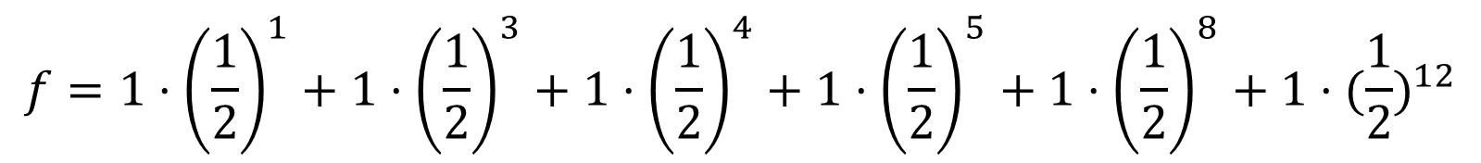
DLI
Illustration:
0 10000000011 1011100100010000000000000000000000000000000000000000
equivalent to the decimal number
$$c=1⋅2^{10}+0⋅2^{9}+…+0⋅2^{2}+1⋅2^{1}+1⋅2^{0}=1024+2+1=1027$$
$$f=1⋅{\left(\frac{1}{2}\right)}^{1}+1⋅{\left(\frac{1}{2}\right)}^{3}+1⋅{\left(\frac{1}{2}\right)}^{4}+1⋅{\left(\frac{1}{2}\right)}^{5}+1⋅{\left(\frac{1}{2}\right)}^{8}+1⋅{(\frac{1}{2})}^{12}$$
$${\left(−1\right)}^{s}2^{c−1023}\left(1+f\right)={(−1)}^{0}⋅2^{1027−1023}(1+(\frac{1}{2}+\frac{1}{8}+\frac{1}{16}+\frac{1}{32}+\frac{1}{256}+\frac{1}{4096}))$$
$$=27.5664065$$

Slide 5
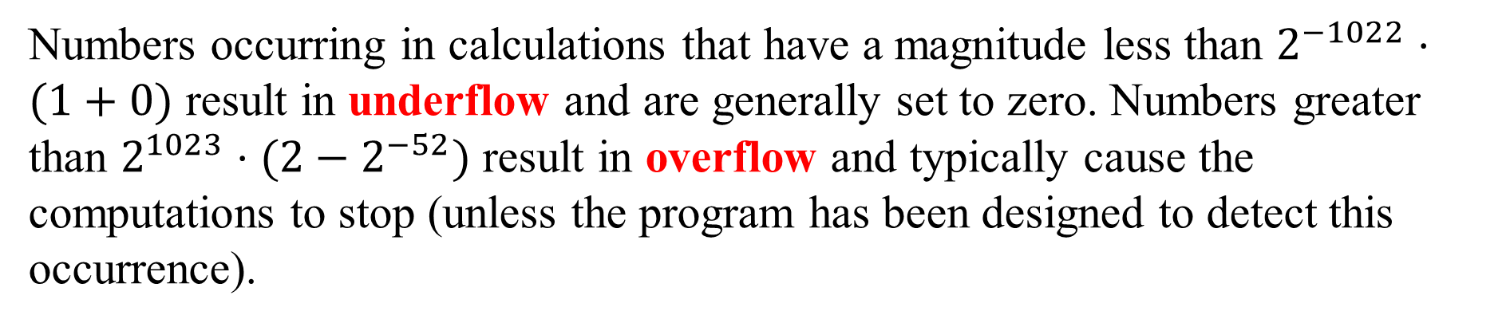
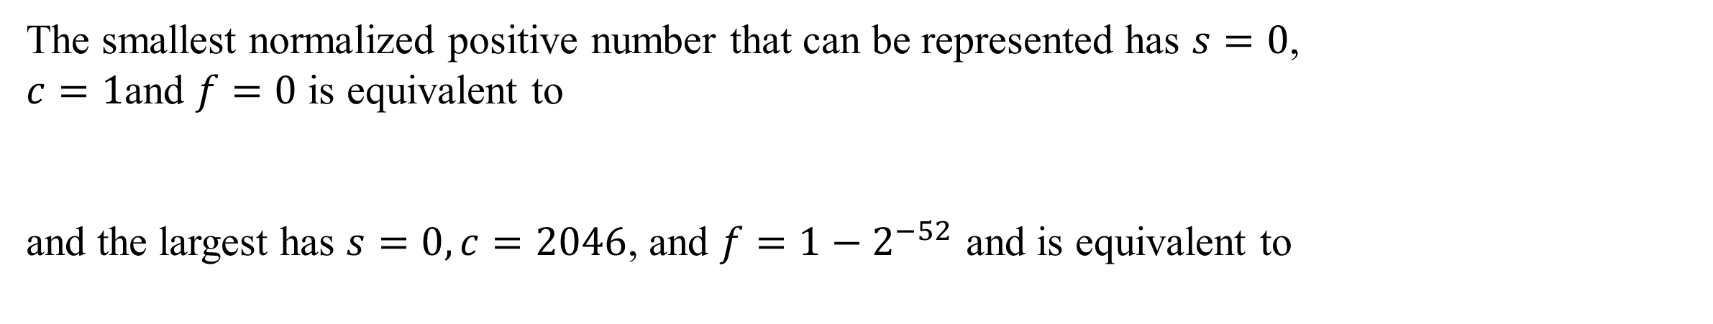
DLI
The smallest normalized positive number that can be represented has $s=0$, $c=1$and $f=0$ is equivalent to
and the largest has $s=0,c=2046$, and $f=1−2^{−52}$ and is equivalent to
$$2^{−1022}⋅(1+0)≈0.22251×{10}^{−307}$$
$$2^{1023}⋅(2−2^{−52})≈0.17977×{10}^{309}$$
Numbers occurring in calculations that have a magnitude less than $2^{−1022}⋅(1+0)$ result in underflow and are generally set to zero. Numbers greater than $2^{1023}⋅(2−2^{−52})$ result in overflow and typically cause the computations to stop (unless the program has been designed to detect this occurrence).

Slide 6
DLI
Decimal Machine Numbers
The use of binary digits tends to conceal the computational difficulties that occur when a finite collection of machine numbers is used to represent all the real numbers.
We will use more familiar decimal numbers instead of binary representation.
we assume that machine numbers are represented in the normalized decimal
floating-point form
$±0.d_{1}d_{2}…d_{k}×{10}^{n}$, ${1≤d}_{1}≤9$, and ${1≤d}_{i}≤9$, for each $i=2,…,k$
We call it $k$-digit decimal machine numbers.

Slide 7
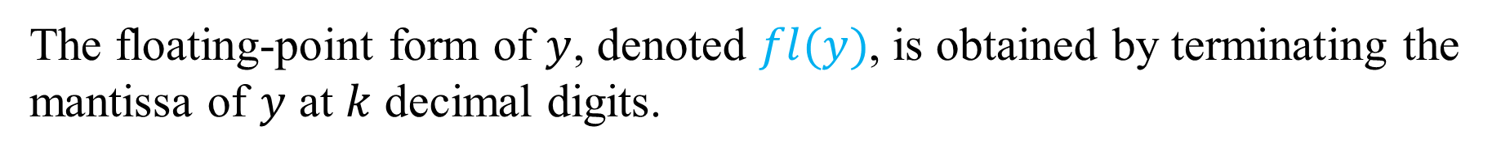
DLI
Decimal Machine Numbers
Any positive real number within the numerical range of the machine can be normalized to the form
$$y=0.d_{1}d_{2}…d_{k}d_{k+1}d_{k+2}…×{10}^{n}$$
The floating-point form of $y$, denoted $fl(y)$, is obtained by terminating the
mantissa of $y$ at $k$ decimal digits.

Slide 8


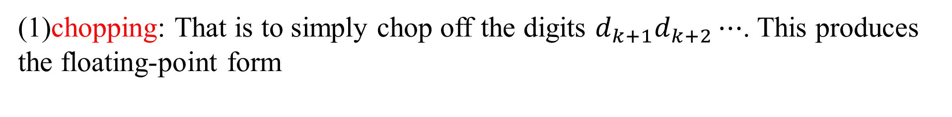
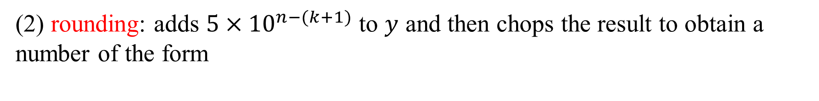

DLI
There are two common ways of performing this termination.
(1)chopping: That is to simply chop off the digits $d_{k+1}d_{k+2}⋯$. This produces the floating-point form
$$fl(y)=0.d_{1}d_{2}…d_{k}×{10}^{n}$$
(2) rounding: adds $5×{10}^{n−(k+1)}$ to $y$ and then chops the result to obtain a number of the form
$$fl(y)=0.δ_{1}δ_{2}…δ_{k}×{10}^{n}$$
For rounding, $d_{k+1}≥5$, we add 1 to $d_{k}$ to obtain $fl(y)$; that is round up. when $d_{k+1}<5$, we chop off all but the first k digits; that is round down.

Slide 9
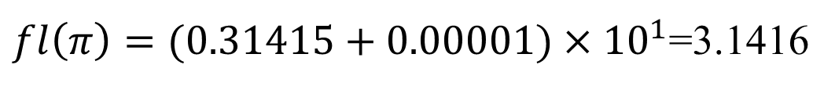
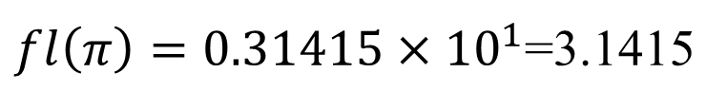

DLI
Example 1 Determine the five-digit (a) chopping and (b) rounding values of the
irrational number π.
Solution:
Written in normalized decimal form, we have
(a) The floating-point form of π using five-digit chopping is
$$π=0.314159265…×{10}^{1}$$
$fl\left(π\right)=0.31415×{10}^{1}$=3.1415
(b) The sixth digit of the decimal expansion of π is a 9, so the floating-point form of π using five-digit rounding is
$fl\left(π\right)=(0.31415+0.00001)×{10}^{1}$=3.1416

Slide 10
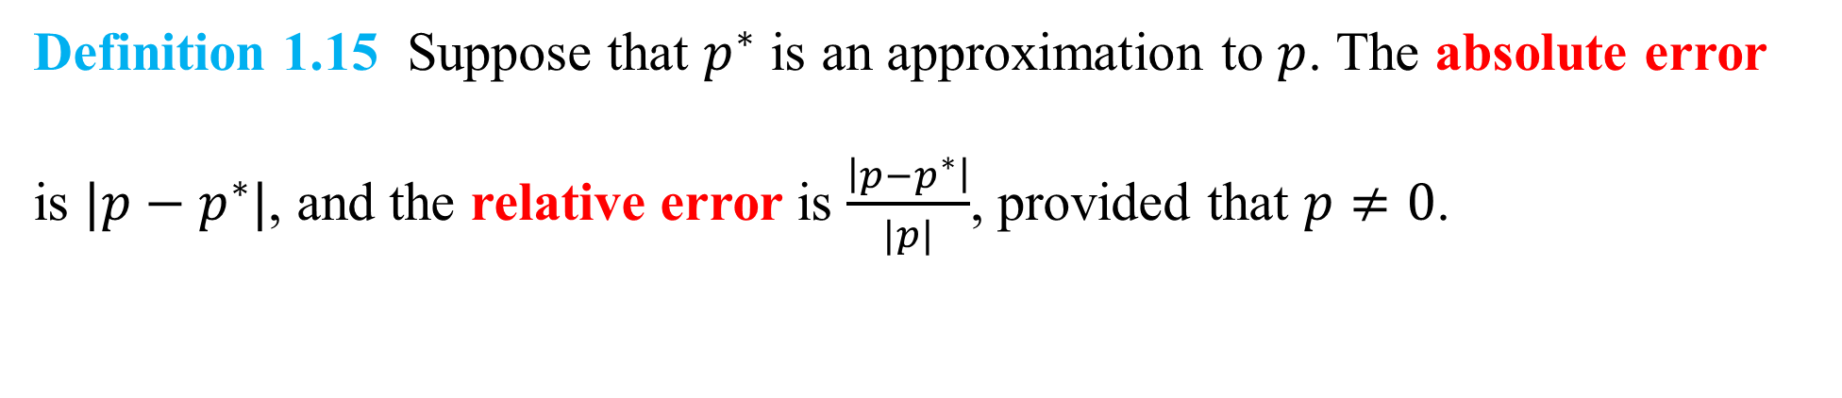
DLI
Definition 1.15 Suppose that $p^{∗}$ is an approximation to $p$. The absolute error
is $|p−p^{∗}|$, and the relative error is $\frac{\left|p−p^{∗}\right|}{|p|}$, provided that $p≠0$.

Slide 11

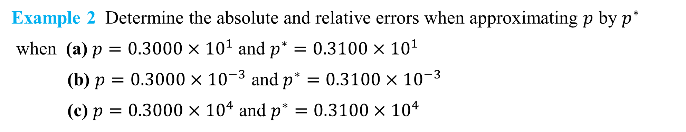
DLI
Example 2 Determine the absolute and relative errors when approximating $p$ by $p^{∗}$
when (a) $p=0.3000×{10}^{1}$ and $p^{∗}=0.3100×{10}^{1}$
(b) $p=0.3000×{10}^{−3}$ and $p^{∗}=0.3100×{10}^{−3}$
(c) $p=0.3000×{10}^{4}$ and $p^{∗}=0.3100×{10}^{4}$
Solution:
(a) the absolute error is 0.1, and the relative error is $0.333\overline{3}×{10}^{−1}$
(b) the absolute error is $0.1×{10}^{−4}$, and the relative error is $0.333\overline{3}×{10}^{−1}$.
(c) the absolute error is $0.1×{10}^{3}$, and the relative error is $0.333\overline{3}×{10}^{−1}$.
This example shows that the same relative error, occurs for widely varying absolute errors.
As a measure of accuracy, the absolute error can be misleading and the relative error more meaningful, because the relative error takes into consideration the size of the value.

Slide 12
DLI
In scientific measurements, it is almost always the relative error that is significant.
Significant digits (or figures) are the leading nonzero digit and all following digits.

Slide 13


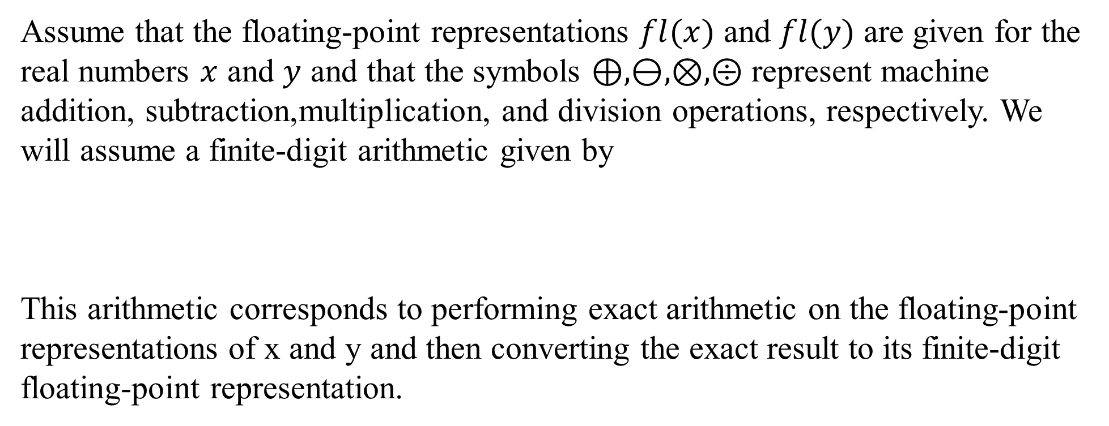


DLI
Finite-Digit Arithmetic
Assume that the floating-point representations $fl(x)$ and $fl(y)$ are given for the real numbers $x$ and $y$ and that the symbols $⊕,⊖,⊗,⨸$ represent machine addition, subtraction,multiplication, and division operations, respectively. We will assume a finite-digit arithmetic given by
This arithmetic corresponds to performing exact arithmetic on the floating-point representations of x and y and then converting the exact result to its finite-digit floating-point representation.
$x⊕y=fl(fl\left(x\right)+fl\left(y\right))$
$x⊗y=fl(fl\left(x\right)×fl\left(y\right))$
$x⊖y=fl(fl\left(x\right)−fl\left(y\right))$
$$x⨸y=fl(fl\left(x\right)÷fl\left(y\right))$$

Slide 14
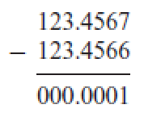
DLI
Loss of significance
One major problem that arises in many forms is the loss of significant digits that results from subtracting nearly equal numbers. Assume that through considerable effort, as part of a long calculation, we have determined two numbers correct to seven significant digits, and now need to subtract them:
The two input numbers are seven-digit accuracy, and ended with a result that has only one-digit accuracy.

Slide 15
DLI
Example
Calculate $\sqrt{9.01}−3$ on a three-decimal-digit computer.

Slide 16
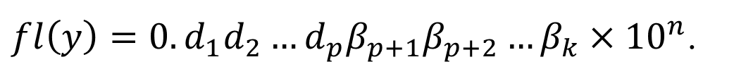
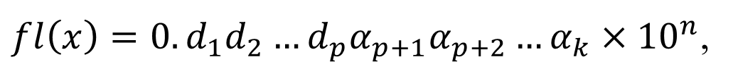
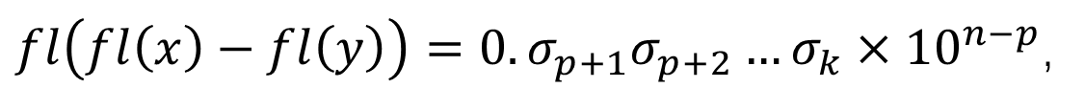
DLI
Suppose two nearly equal numbers $x$ and $y$, with $x>y$, have the $k$-digit representations
$fl\left(x\right)=0.d_{1}d_{2}…d_{p}α_{p+1}α_{p+2}…α_{k}×{10}^{n}$,
and
$fl\left(y\right)=0.d_{1}d_{2}…d_{p}β_{p+1}β_{p+2}…β_{k}×{10}^{n}$.
The floating-point form of $x−y$ is
$fl\left(fl\left(x\right)−fl\left(y\right)\right)=0.σ_{p+1}σ_{p+2}…σ_{k}×{10}^{n−p}$,
where
$0.σ_{p+1}σ_{p+2}…σ_{k}=0. α_{p+1}α_{p+2}…α_{k}−0.β_{p+1}β_{p+2}…β_{k}$.

Slide 17
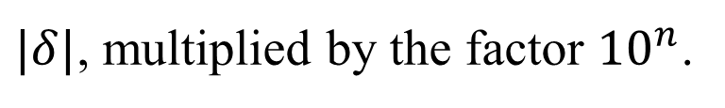
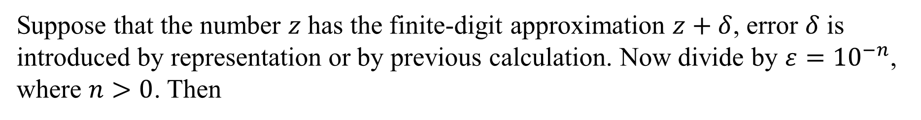
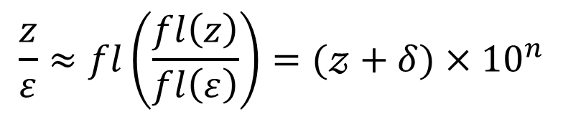
DLI
If a finite-digit representation or calculation introduces an error, further enlargement
of the error occurs when dividing by a number with small magnitude (or,
equivalently, when multiplying by a number with large magnitude).
Suppose that the number $z$ has the finite-digit approximation $z+δ$, error $δ$ is introduced by representation or by previous calculation. Now divide by $ε={10}^{−n}$, where $n>0$. Then
$$\frac{z}{ε}≈fl\left(\frac{fl\left(z\right)}{fl\left(ε\right)}\right)=(𝓏+δ)×{10}^{n}$$
The absolute error in this approximation, $|δ| × {10}^{n}$, is the original absolute error,
$|δ|$, multiplied by the factor ${10}^{n}$.

Slide 18
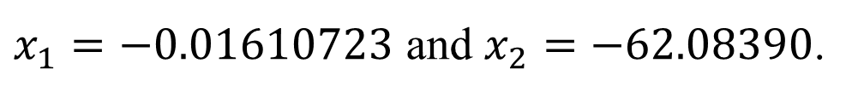
DLI
Illustration
Consider this formula applied to the equation $x^{2}+62.10x+1=0$, whose roots
are approximately
$x_{1}=−0.01610723$ and $x_{2}=−62.08390$.
We will again use four-digit rounding arithmetic in the calculations to determine the
root. In this equation, $b^{2}$ is much larger than $4ac$, so the numerator in the calculation
for $x_{1}$ involves the subtraction of nearly equal numbers.

Slide 19

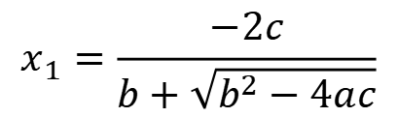
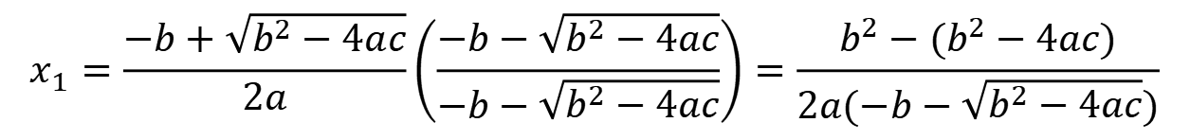
DLI
To obtain a more accurate four-digit rounding approximation for $x_{1}$, we change
the form of the quadratic formula by rationalizing the numerator:
$$x_{1}=\frac{−b+\sqrt{b^{2}−4ac}}{2a}\left(\frac{−b−\sqrt{b^{2}−4ac}}{−b−\sqrt{b^{2}−4ac}}\right)=\frac{b^{2}−(b^{2}−4ac)}{2a(−b−\sqrt{b^{2}−4ac})}$$
which simplifies to an alternate quadratic formula
$$x_{1}=\frac{−2c}{b+\sqrt{b^{2}−4ac}}$$
$$(1.2)$$

Slide 20
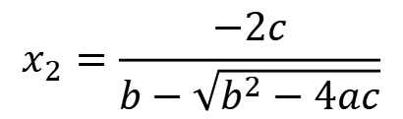

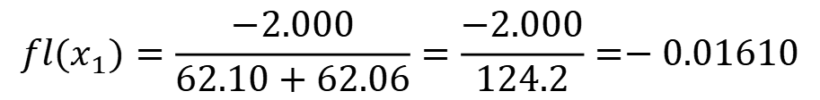
DLI
Using (1.2) gives
$${fl(x}_{1})=\frac{−2.000}{62.10+62.06}=\frac{−2.000}{124.2}=−0.01610$$
which has the small relative error $6.2×{10}^{−4}$.
The rationalization technique can also be applied to give the following alternative
quadratic formula for $x_{2}$:
$$x_{2}=\frac{−2c}{b−\sqrt{b^{2}−4ac}}$$
This is the form to use if $b$ is a negative number.

Slide 21
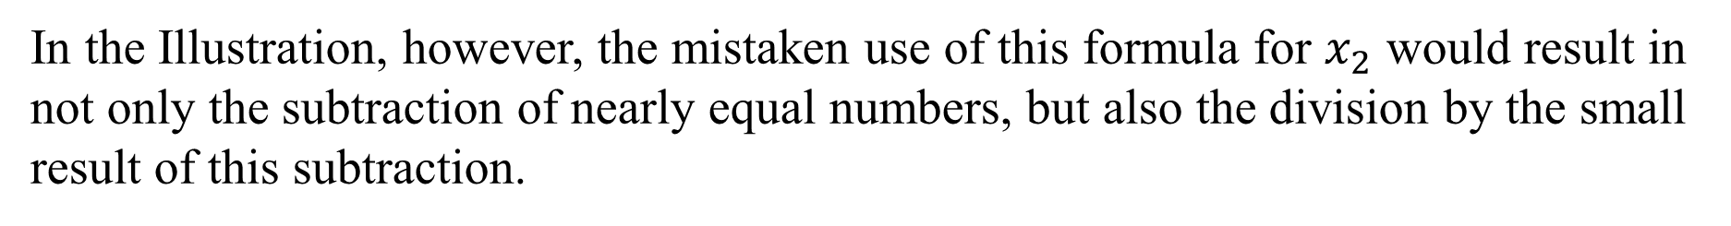
DLI
In the Illustration, however, the mistaken use of this formula for $x_{2}$ would result in not only the subtraction of nearly equal numbers, but also the division by the small result of this subtraction.
The inaccuracy that this combination produces,
$${fl(x}_{2})=\frac{−2c}{b−\sqrt{b^{2}−4ac}}=\frac{−2.000}{62.10−62.06}=\frac{−2.000}{0.04000}=−50.00$$
has the large relative error $1.9×{10}^{−1}$.

Slide 22
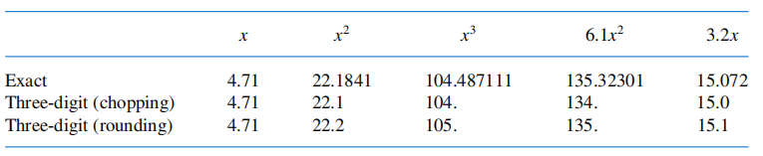
DLI
Nested Arithmetics
Accuracy loss due to round-off error can also be reduced by rearranging calculations
Example 6
Evaluate $f\left(x\right)=x^{3}−6.1x^{2}+3.2x+1.5$ at $x=4.71$ using three-digit
arithmetic.
Solution:
Table 1.4 gives the intermediate results in the calculations.
Table 1.4

Slide 23
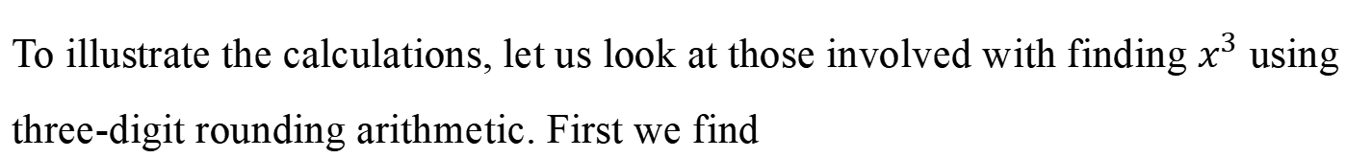
DLI
To illustrate the calculations, let us look at those involved with finding $x^{3}$ using three-digit rounding arithmetic. First we find
$x^{2}={4.71}^{2}=22.1841$ which rounds to 22.2.
$x^{3}=x^{2}⋅x=22.2⋅4.71=104.562$ which rounds to 105.
$6.1x^{2}=6.1⋅22.2=135.42$ which rounds to 135,
$3.2x=3.2⋅4.71=15.072$ which rounds to 15.1.

Slide 24
DLI
Exact: $f\left(4.71\right)=104.487111−135.32301+15.072+1.5=−14.263899$.
Using finite-digit arithmetic, the way in which we add the results can effect the
final result. Suppose that we add left to right. Then for chopping arithmetic we have
Three-digit(chopping): $f\left(4.71\right)=\left(\left(104.−134.\right)+15.0\right)+1.5=−13.5$,
and for rounding arithmetic we have
Three-digit(rounding): $f\left(4.71\right)=\left(\left(105.−135.\right)+15.1\right)+1.5=−13.4$.

Slide 25
DLI
The relative errors for the three-digit methods are
Chopping: $\left|\frac{−14.263899+13.5}{−14.263899}\right|≈0.05$, and Rounding:$\left|\frac{−14.263899+13.4}{−14.263899}\right|≈0.06$.
Illustration
As an alternative approach, the polynomial $f(x)$ in Example 6 can be
written in a nested manner as
$f\left(x\right)=x^{3}−6.1x^{2}+3.2x+1.5=\left(\left(x−6.1\right)x+3.2\right)x+1.5$.

Slide 26




DLI
Using three-digit chopping arithmetic now produces
$$f\left(4.71\right)=\left(\left(4.71−6.1\right)×4.71+3.2\right)×4.71+1.5$$
$$=\left(\left(−1.39\right)×(4.71)+3.2\right)×4.71+1.5$$
$$=\left(−6.54+3.2\right)×4.71+1.5$$
$$=\left(−3.34\right)×4.71+1.5$$
$$=−15.7+1.5$$
$$=−14.2$$

Slide 27

DLI
The new relative errors ars
The decreased error in the Illustration is due to the reduction in computations from four multiplications and three additions to two multiplications and three additions.
Polynomials should always be expressed in nested form before performing an evaluation. One way to reduce round-off error is to reduce the number of computations.
$f\left(x\right)=x^{3}−6.1x^{2}+3.2x+1.5$

Slide 28
DLI

